Slide 1
Devops Training

Slide 2
What is Devops?
The DevOps is the combination of two words, one is Development and other is Operations.
It is a culture to promote the development and operation process collectively.
The DevOps is a combination of two words, one is software Development, and second is Operations.
This allows a single team to handle the entire application lifecycle, from development to testing, deployment, and operations.
DevOps helps you to reduce the disconnection between software developers, quality assurance (QA) engineers, and system administrators.

Slide 3
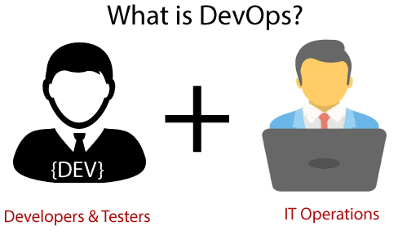

Slide 4
Why Devops?
Before going further, we need to understand why we need the DevOps over the other methods.
The operation and development team worked in complete isolation.
After the design-build, the testing and deployment are performed respectively. That's why they consumed more time than actual build cycles.
Without the use of DevOps, the team members are spending a large amount of time on designing, testing, and deploying instead of building the project.
Manual code deployment leads to human errors in production.
Coding and operation teams have their separate timelines and are not in synch, causing further delays.

Slide 5
Advantages of Devops Practice
DevOps promotes collaboration between Development and Operations team to deploy code to production faster in an automated & repeatable way.
DevOps helps to increase organization speed to deliver applications and services.
It also allows organizations to serve their customers better and compete more strongly in the market.
DevOps can also be defined as a sequence of development and IT operations with better communication and collaboration
DevOps is nothing but a practice or methodology of making "Developers" and "Operations" folks work together.
DevOps represents a change in the IT culture with a complete focus on rapid IT service delivery through the adoption of agile practices in the context of a system-oriented approach
Organizations that have adopted DevOps noticed a 22% improvement in software quality and a 17% improvement in application deployment frequency and achieve a 22% hike in customer satisfaction. 19% of revenue hikes as a result of the successful DevOps implementation.

Slide 6
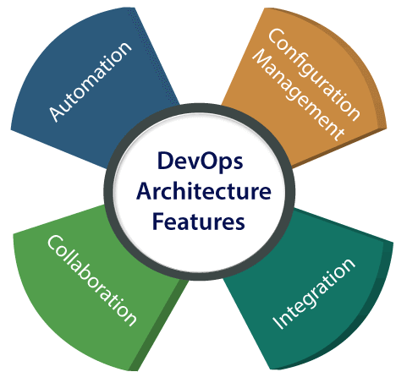
DevOps Architecture Features

Slide 7
Devops Tools
Linux Basics
GIT
Jenkins
Docker
Kubernetes
Ansible
Splunk
CICD
Dynatrace and newrelic
Nagios
Selenium

Slide 8
Learning Path
Linux Basic Commands
aws server creation / gcp
GIT
Jenkins
Docker
Kubernetes
Ansible
Splunk
CICD
Dynatrace and newrelic
Nagios
Selenium

